Slide 1
Tools and Artifacts
Prof. Dr. Dirk Riehle
Friedrich-Alexander University Erlangen-Nürnberg
AMOS B02
Licensed under CC BY 4.0 International

Slide 2
Agenda
Code repository
Project features
Kanban board
Planning docs

Slide 3
Project Management
The AMOS Project directive is simplify, simplify, simplify!
  GitHub repository, issues, and project for software development
  Google Sheets for high-level product and process management
  Teams may add additional tools at their discretion (and own risk)

Slide 4
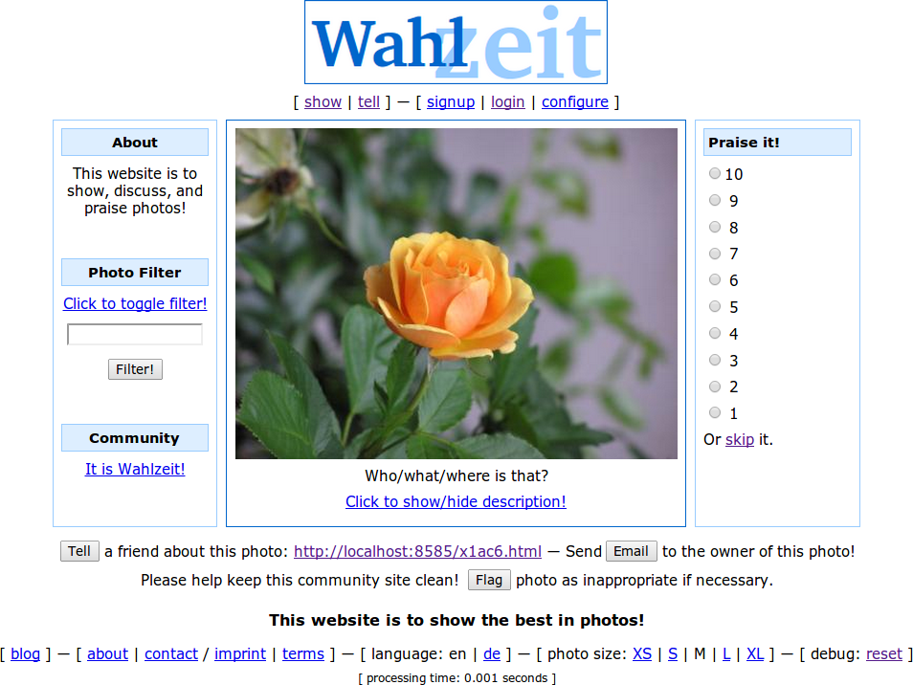
The Wahlzeit / Flowers Example

Slide 5
1. Code Repository

Slide 6
GitHub Code Repository Set-up
GitHub account
  Please create a GitHub account if you don’t have one yet
  Send your account name (handle) to team coach
GitHub project
  The team coach will create a team for you and invite you to a code repository
  You will all be owners of the code repository, initially; change as you see fit
Your project name will be amos-ss20xx-fabulous-project
  It will be public (read access to world)
  It uses the MIT license
You can collaborate as you see fit (but should agree first)

Slide 7
2. Project Features

Slide 8
Feature and User Story
Definition of feature
  A distinguishing characteristic of a software item (for example, performance, portability, functionality)
  (IEEE 829)
Definition of user story
  A description mechanism for a software feature used to create a shared understanding of the feature; follows an established pattern
  The description pattern is: As a “user role”, I need “a function”, so that “I get business value” where the parts in quotation marks are substituted
Example user stories
  Rate-a-photo: As a visitor, I can rate a photo with a numerical value 1-10, so that I can share my opinion about the photo.
  Tell-a-friend: As a user, I need a function to tell a friend about a flower photo, so that I can share my passion for flowers.

Slide 9
Types of Issues
Features
  New functional improvements
Refactorings
  Behavior-preserving improvements
Bugs
  Fixes to malfunctioning

Slide 10
Quality Criteria for Features
I | ndependent: Features should be independent of each other.
N | egotiable: A feature is man-made, not cast in stone.
V | aluable: Every feature should have business value.
E | stimatable: A feature should be precise so that size can be estimated.
S | mall: A feature should be small enough for one iteration.
T | estable: A feature should have testable success criteria.

Slide 11
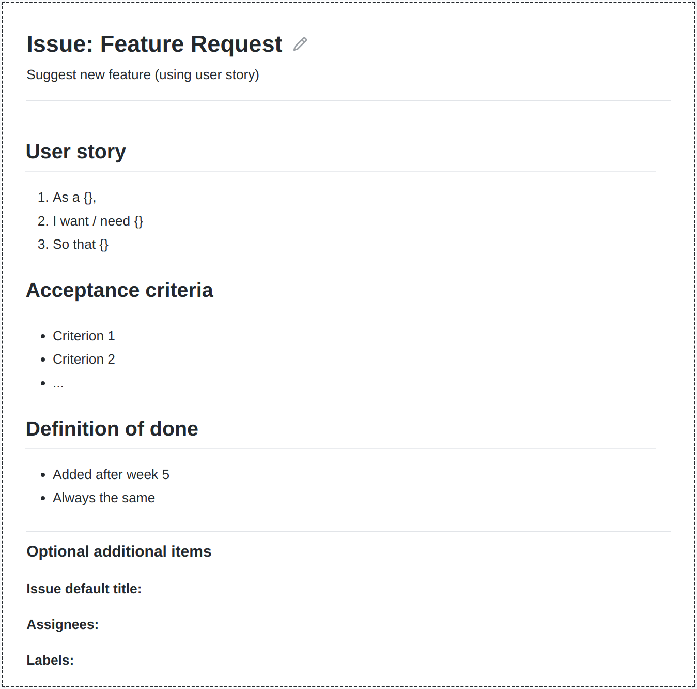
GitHub Issues Set-up
GitHub issue template
  Please create a template for feature requests
  The template should contain fields for
    Short name (already preset as title field)
    Short description (using user story)
    Acceptance criteria (to test for fulfillment)
    Definition of done (from week 5 on)
Create labels for features sizes
  Est. size = X for estimated sizes
    Set during sprint planning
  Real size = Y for actual size
    Set during sprint review
  Use escalating colors
Feel free to add more templates

Slide 12
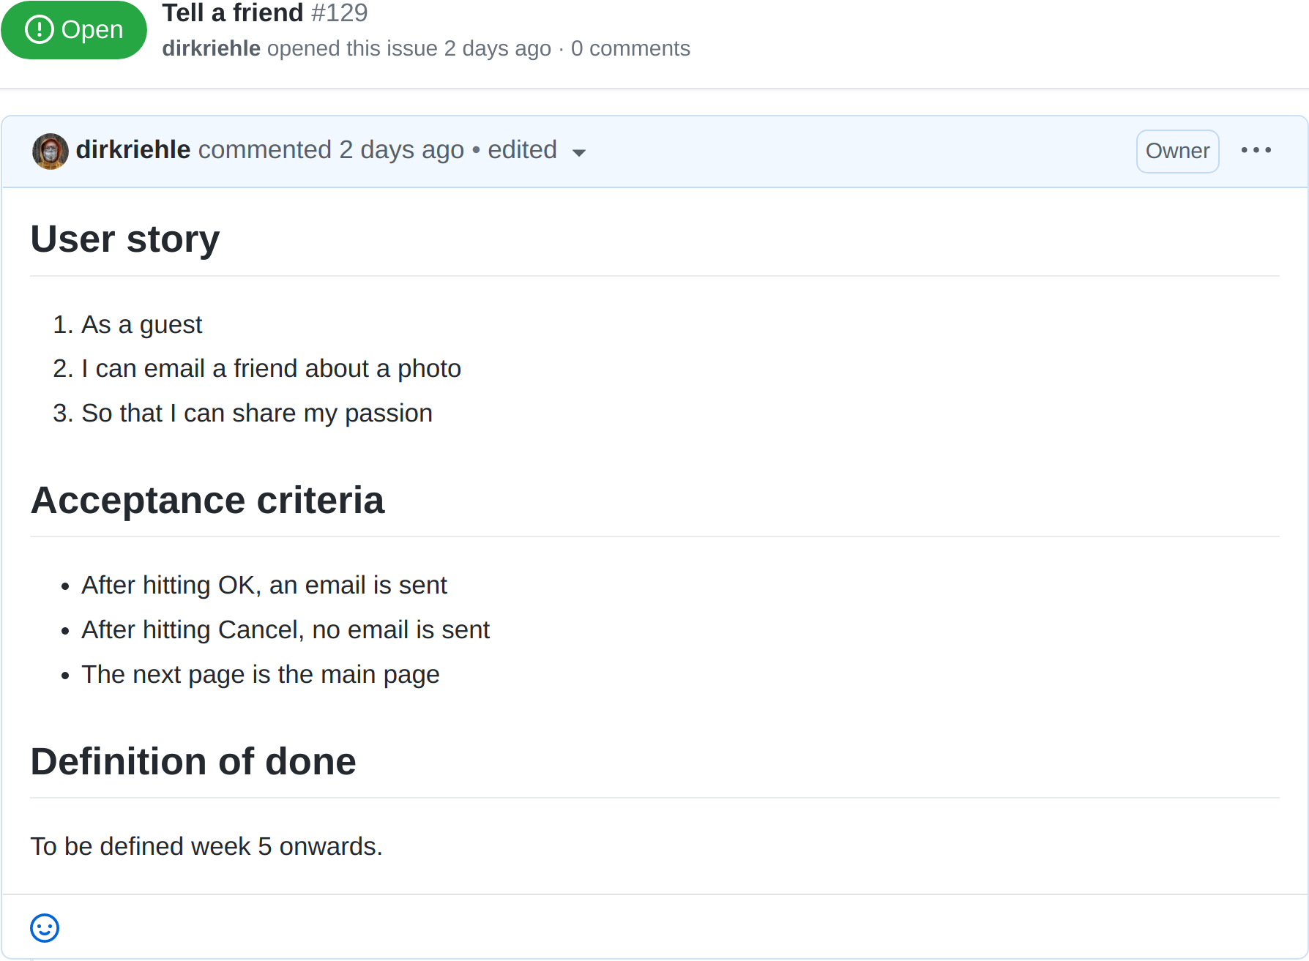
The Tell a Friend Feature 1 / 2

Slide 13
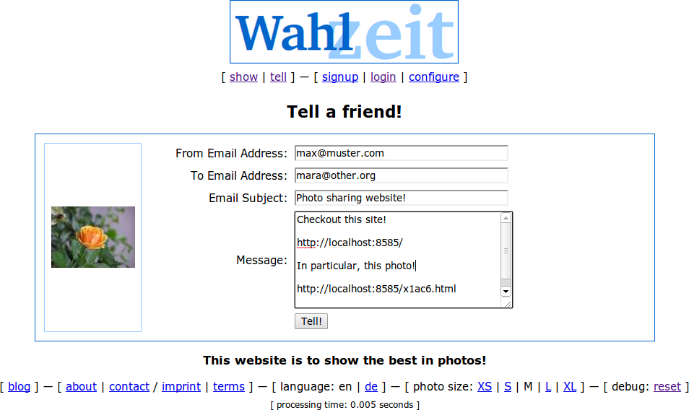
The Tell a Friend Feature 2 / 2

Slide 14
3. Kanban Board

Slide 15
The Feature Life-Cycle
Product Backlog
Sprint Backlog
In progress
Awaiting review
Feature Archive
2. Tell-a-friend
Est. size = 8
3. Tell-a-friend
Est. size = 8
4. Tell-a-friend
Est. size = 8
5. Tell-a-friend
Est. size = 8 Real size = 8
6. Tell-a-friend
Est. size = 8 Real size = 8
...
...
...
...
...
...
...
1. Tell-a-friend

Slide 16
Product Backlog and Product Backlog Entry
Product backlog entry
  A named, identifiable, and prioritized feature, bug, or refactoring
Product backlog
  An incomplete, evolving list of features prioritized by business value
Purpose of product backlog
  To know what’s coming up next

Slide 17
Sprint Backlog and Sprint Backlog Entry
Sprint backlog entry
  A high-quality product backlog entry that
    has been estimated for size and committed-to to being implemented by the software developers
Sprint backlog
  A list of sprint backlog entries that
    the software developers have committed to implementing in the current sprint
Purpose of sprint backlog
  To know at any time what to do in the current sprint
  To serve for task allocation between developers

Slide 18
Feature Archive
Feature archive
  All issues that have been implemented
  All issues contain the original size estimation
  All issues contain the real (after-implementation) size
Purpose of feature archive
  To serve as a summary of product features
  To allow lookup of history of development

Slide 19
GitHub Project Set-up
GitHub project
  Please create a project (board) for backlogs
  The board should have five columns
    Product backlog (for new unscheduled features)
    Sprint backlog (for features to-be-done)
    In progress (for features currently in work)
    Awaiting review (for features to be reviewed)
    Feature archive (for finished features)
Connect issues with project

Slide 20
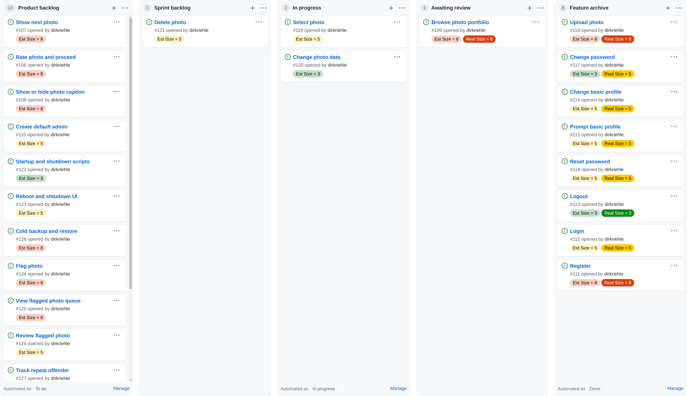
The Wahlzeit / Flowers Kanban Board

Slide 21
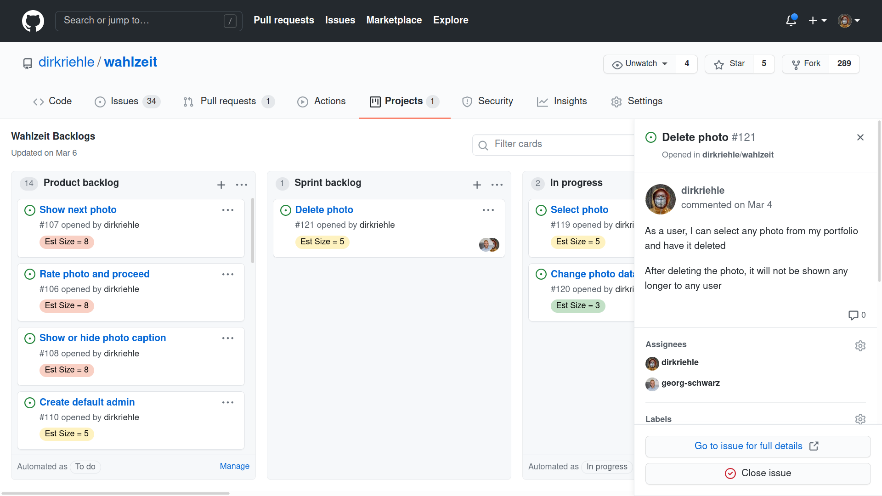
Task Planning / Assigning Backlog Entries

Slide 22
4. Planning Documents

Slide 23
Strategic Planning Set-up
Strategic planning uses Google Sheets
  Please copy the planning documents template: http://goo.gl/Brc0Q
  Share your copy with the team and the coach
Wahlzeit / Flowers example
  Planning artifacts: http://bit.ly/3qitBF1

Slide 24
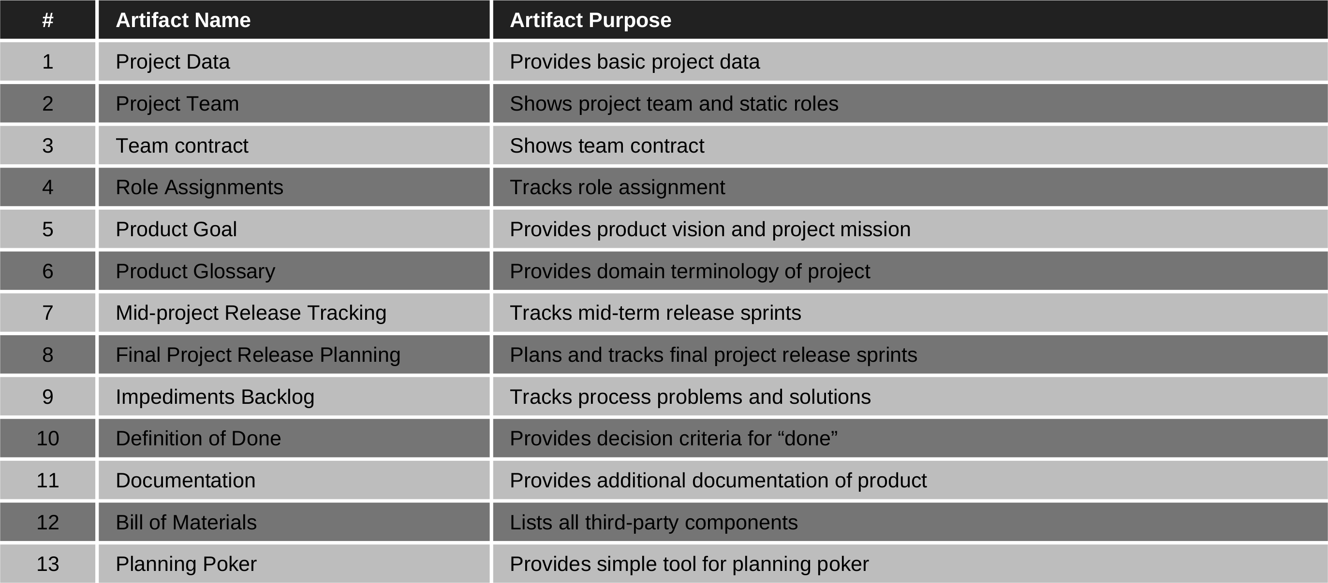
Strategic Planning Document

Slide 25
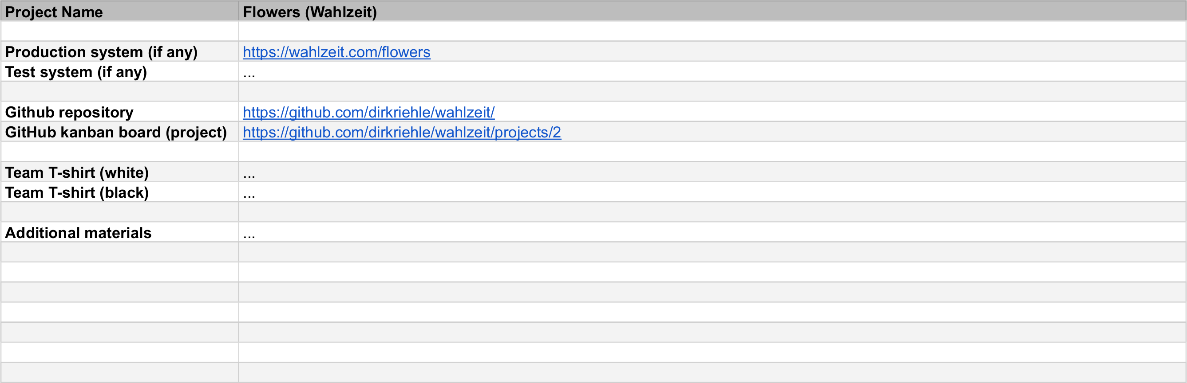
1. Project Data

Slide 26
1. Project Data (Explanation)
Definition
  A collection of relevant (starting point) links
Purpose
  To simplify navigation
Production and system
  Deployment scenarios depend on project
GitHub repository
  Required
CI tooling
  Optional

Slide 27
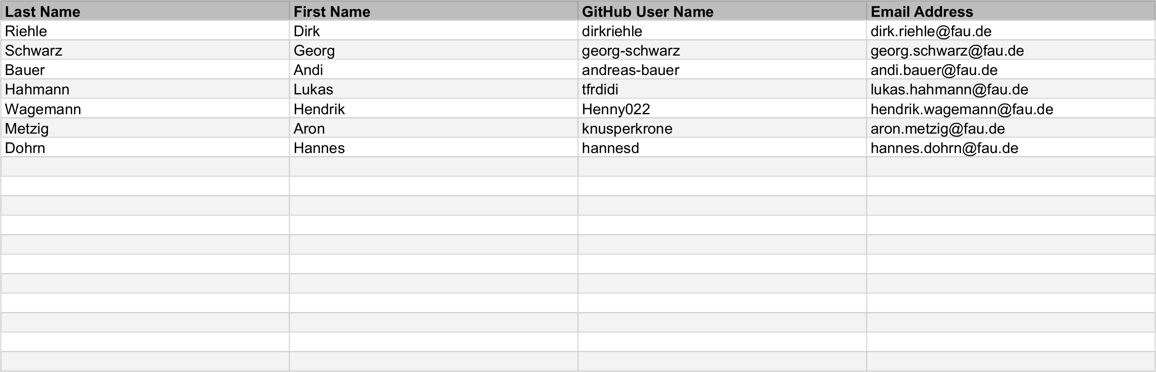
2. Project Team

Slide 28
2. Project Team (Explanation)
Definition
  The list of team members and their contact information
Purpose
  To make it easy to contact individuals or the whole team
Pragmatics
  Feel free to add other information, e.g. Skype ID

Slide 29
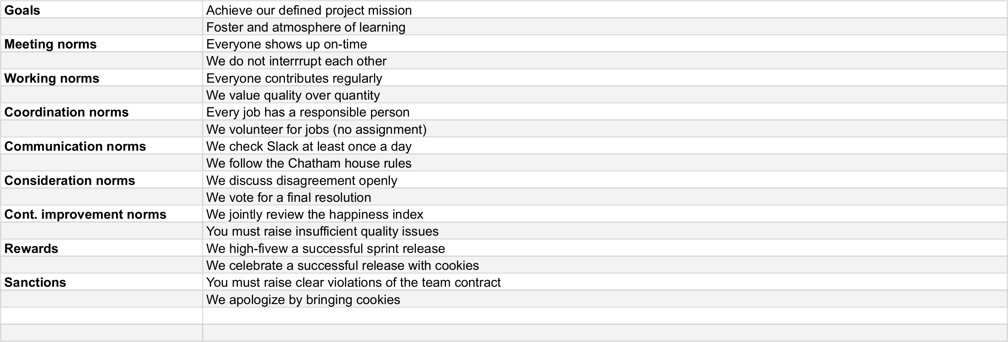
3. Team Contract

Slide 30
3. Team Contract (Explanation) [1]
Definition
  A uniform agreement of the team as to which goals, norms, rewards, and sanctions they play by
Purpose
  To have a defined and agreed-upon way of operating as a team
[1] https://oss.cs.fau.de/teaching/course-resources/student-team-contract/

Slide 31
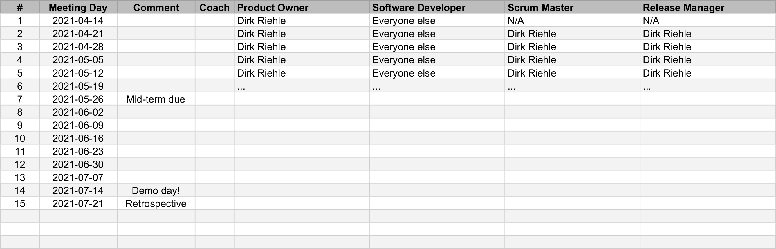

4. Role Assignments

Slide 32
4. Role Assignments (Explanation)
Definition
  A week-by-week assignment of roles to team members
Purpose
  To have a plan and history of role assignments so everyone knows their job
Pragmatics
  Please plan out the project at start of course
  Feel free to add roles beyond the four required ones
Use the same week numbers as in the Course schedule
  Week 1 starts with the first lecture
  Week 1 also starts the first sprint

Slide 33
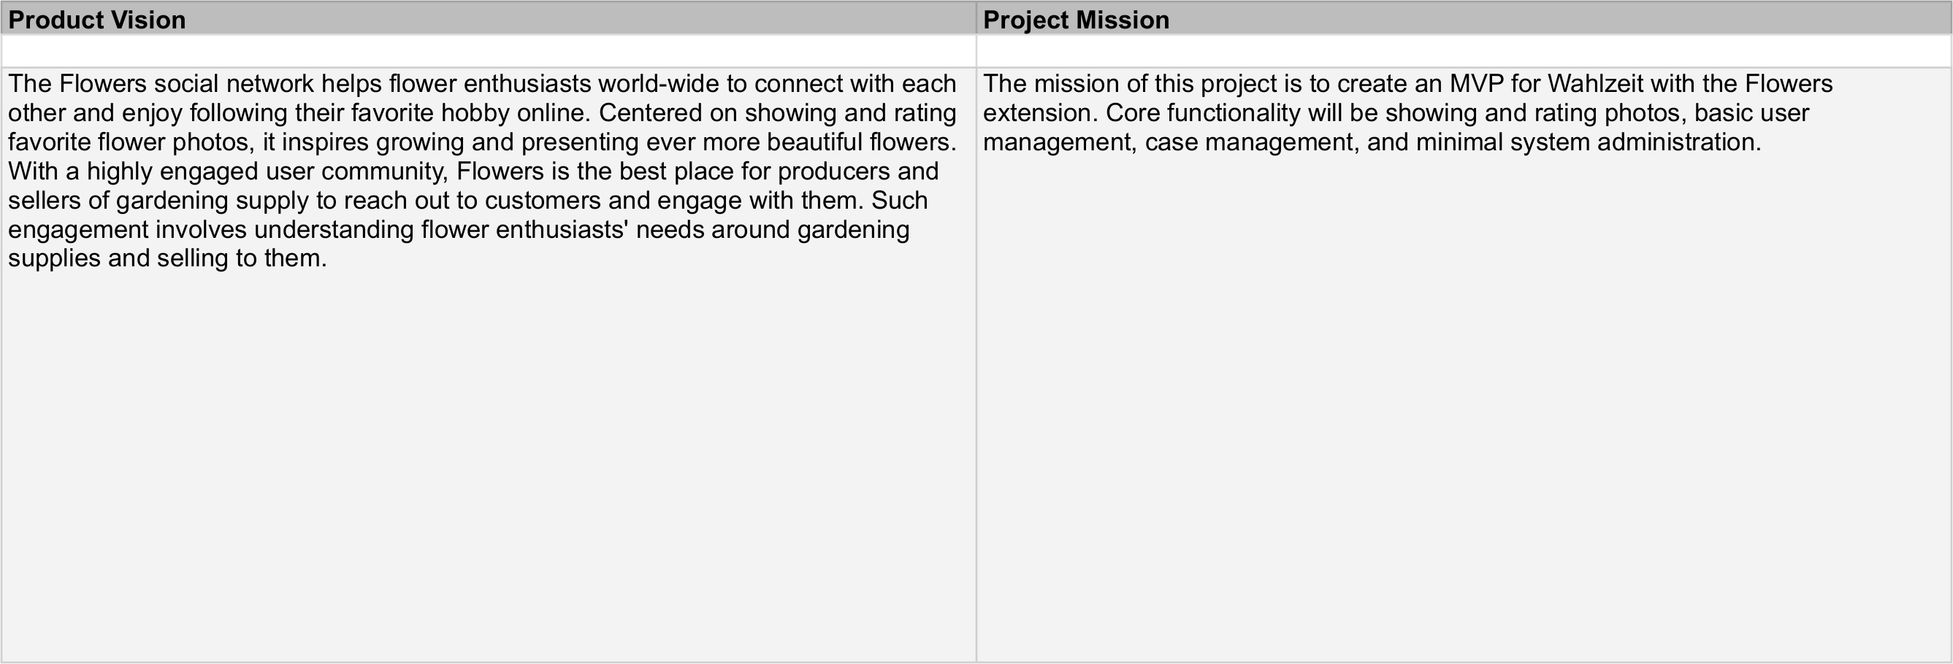
5. Product Goal

Slide 34
5. Product Goal (Vision and Mission)
Definition of product vision
  A product vision communicates
    The main purpose and core functionality of the product
    The value the main stakeholders receive
  It is inspiring, timeless, focused and the final arbiter
Definition of project mission
  A project mission summarizes
    What the project wants to achieve
    Within the project time-frame
Purpose
  To succinctly explain product and project
  To guide when prioritizing features

Slide 35
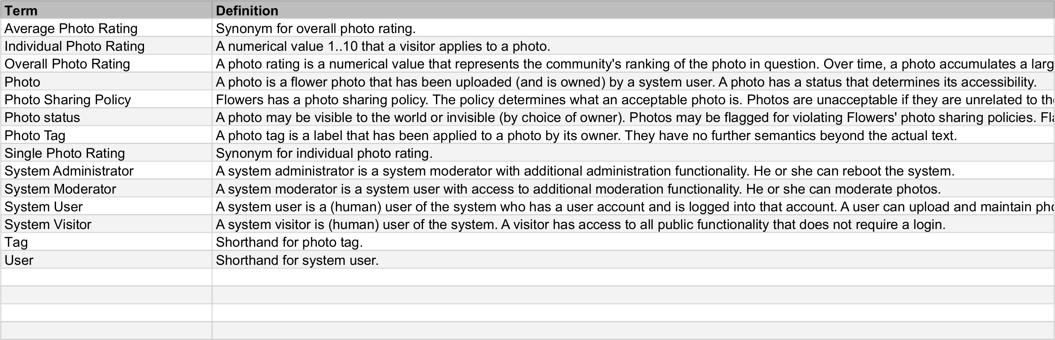
6. Product Glossary

Slide 36
6. Product Glossary (Explanation)
Definition
  Is an alphabetically ordered list of terms and their definition
Purpose
  To provide key domain terminology (shared vocabulary) of project
  Is a simplified form of a domain model accessible to everyone
Term
  A (possibly qualified) noun determining the concept to be defined
Term definition
  The definition of the referenced term
  A base definition is a declarative statement of the form X is a X*
  Other forms of definitions are synonyms, short-hands, etc.

Slide 37
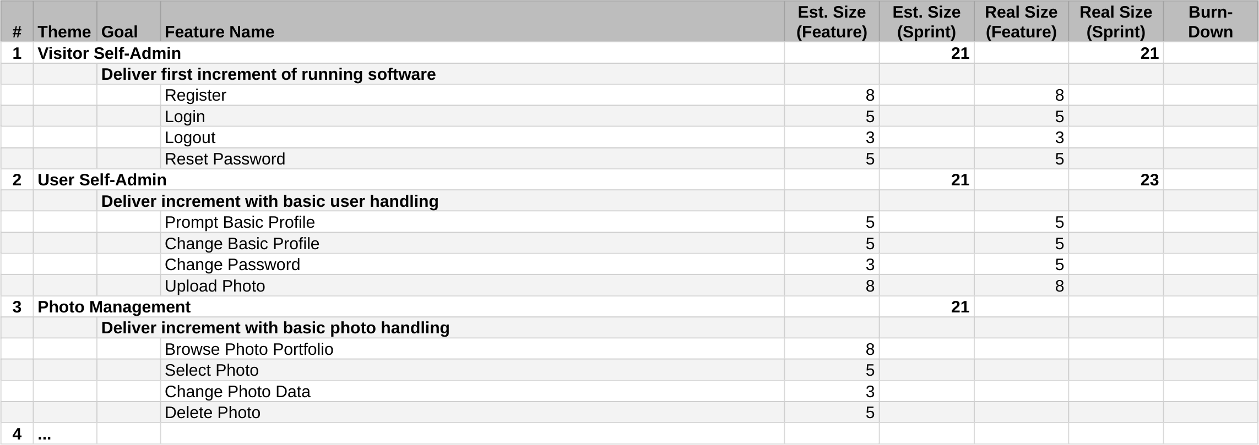
7. Mid-Project Release Tracking

Slide 38
7. Mid-Project Release Tracking (Explanation)
Definition
  A prioritized list of features for a product release
Purpose
  To predict the content of the upcoming product release
Pragmatics
  Has been estimated by developers, validated by historic data
  Is a living document, that is, gets adjusted after each sprint

Slide 39
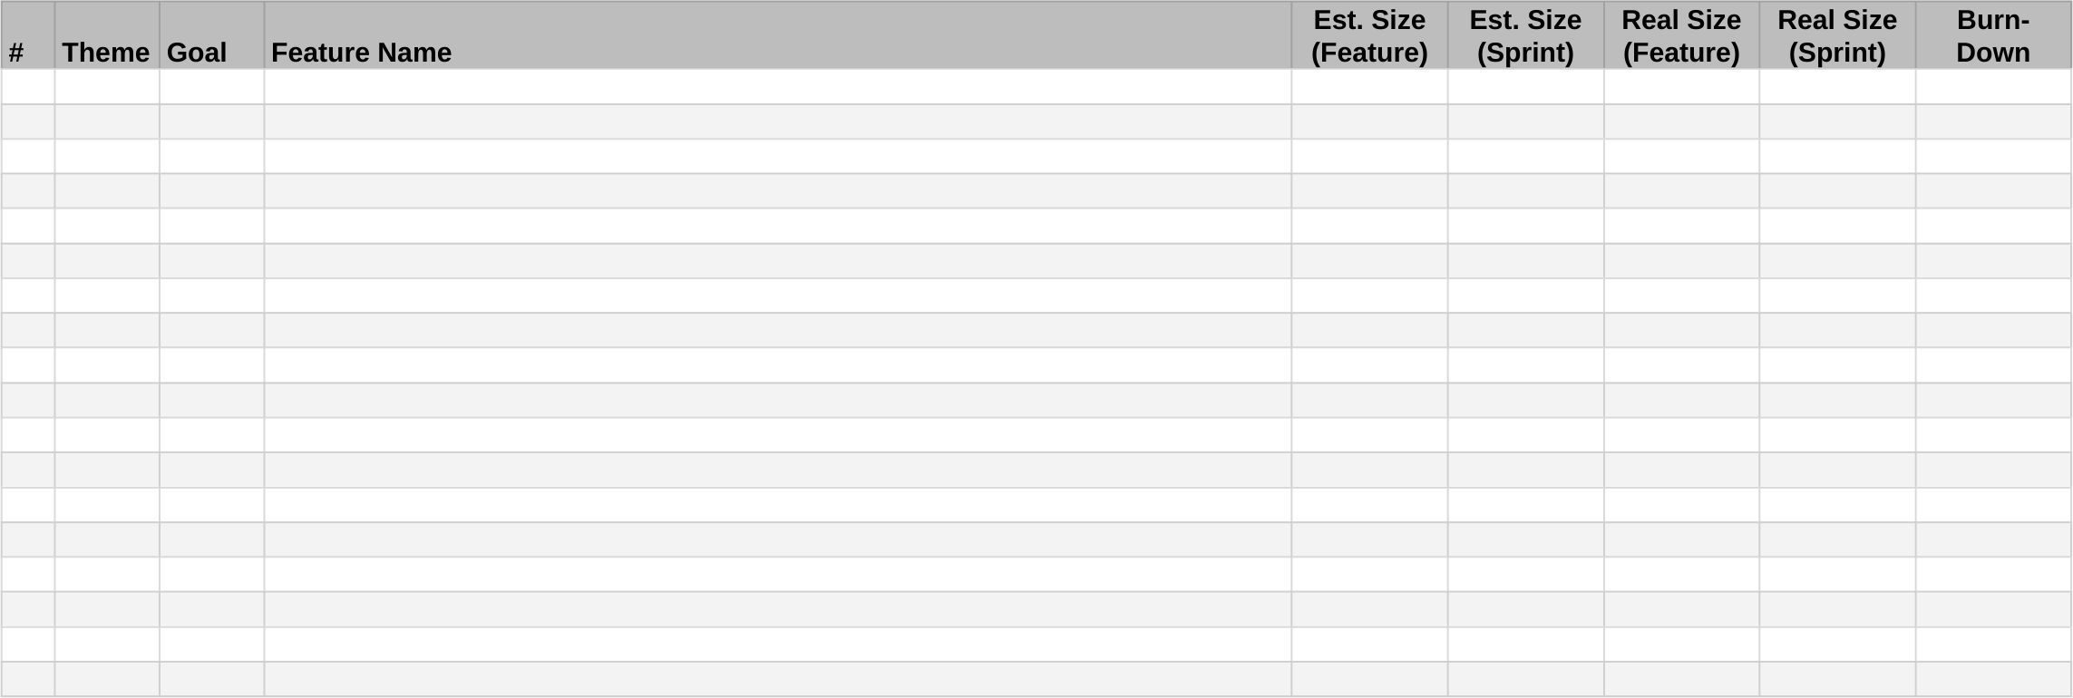
8. Final Project Release Planning and Tracking

Slide 40
8. Final Project Release Planning and Tracking (Explanation)
Like mid-project release tracking, but with added planning

Slide 41
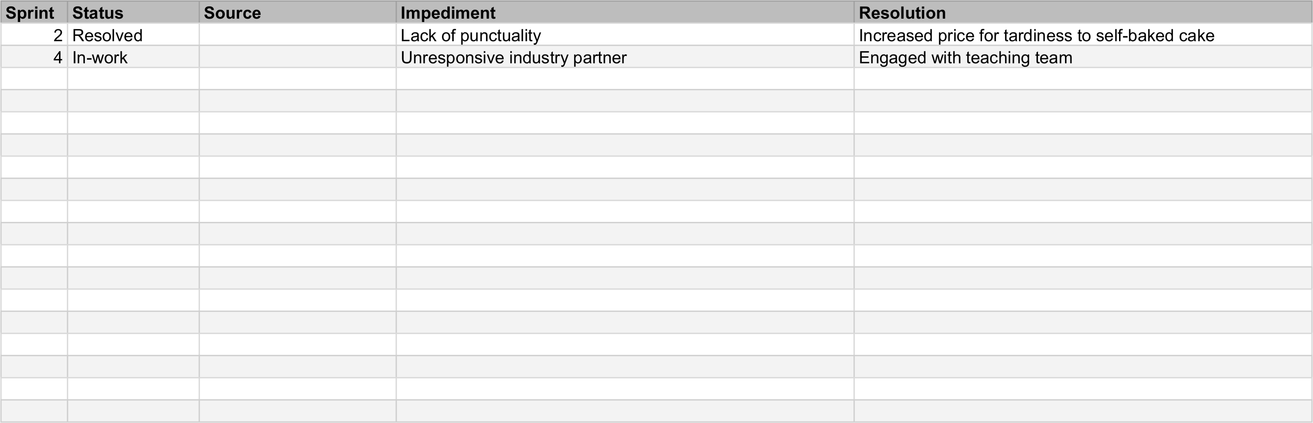
9. Impediments Backlog

Slide 42
9. Impediments Backlog (Explanation)
Definition
  A list of current and historic impediments to process
Purpose
  To know at any time the current impediments
  To see whether any impediments keep recurring
Pragmatics
  It names the Scrum master responsible for resolution
  It provides the solution found, if any

Slide 43
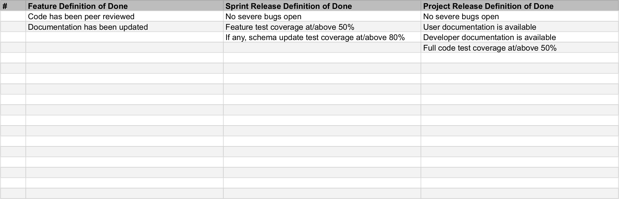
10. Definition of Done

Slide 44
10. Definition of Done (Explanation)
Definition
  Is a check list of decision criteria to determine status of “done”
Purpose
  To be consistent about what “done” means
Pragmatics
  Definitions of “done” (DoD) require team consensus
  There are many such decisions, hence many DoDs needed
  At a minimum, at the proper time, the team should have a
    DoD for features
    DoD for sprint release
    DoD for product release

Slide 45
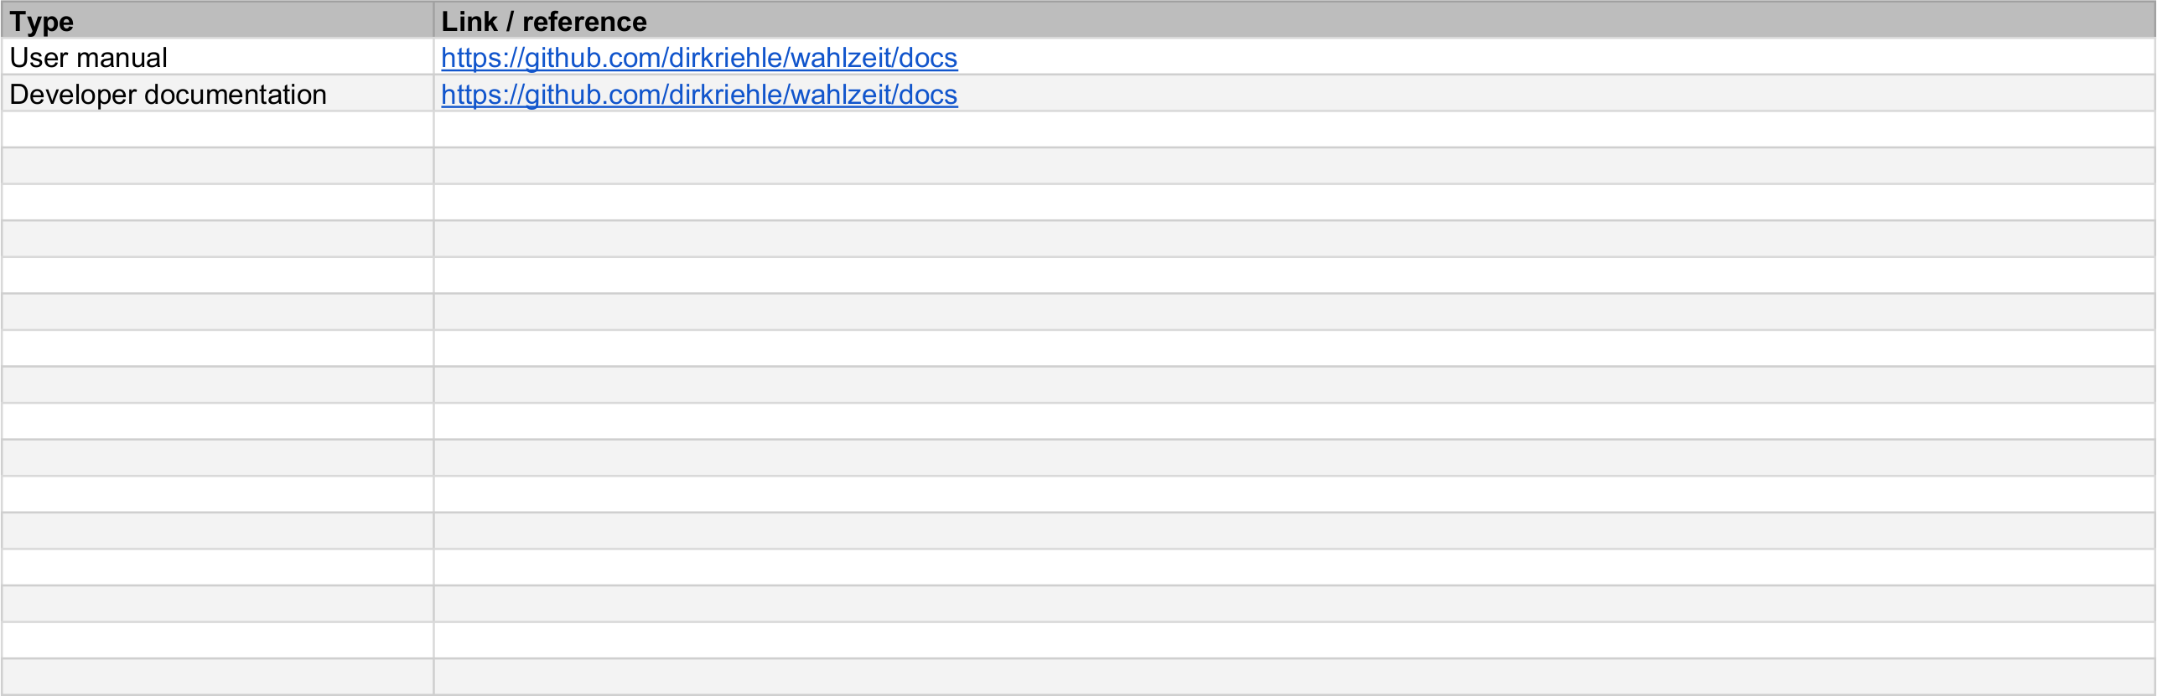
11. Documentation

Slide 46
11. Documentation (Explanation)
Definition
  The product documentation (where to find what)

Slide 47
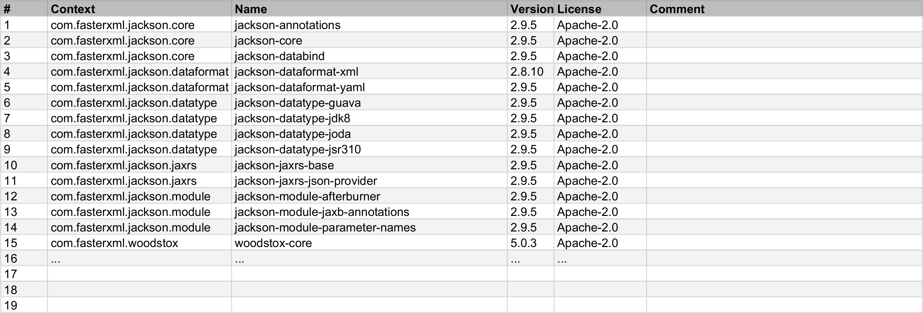
12. Bill of Materials

Slide 48
12. Bill of Materials (Explanation)
Definition
  A list of items (“materials”) included in the project
  Items typically mean open source libraries
Purpose
  To maintain an overview of “what’s the box”
Pragmatics
  Please lists all third-party components used by the product
  List only those used directly; no need to recursively unpack
  In case of open source components, also list their license

Slide 49
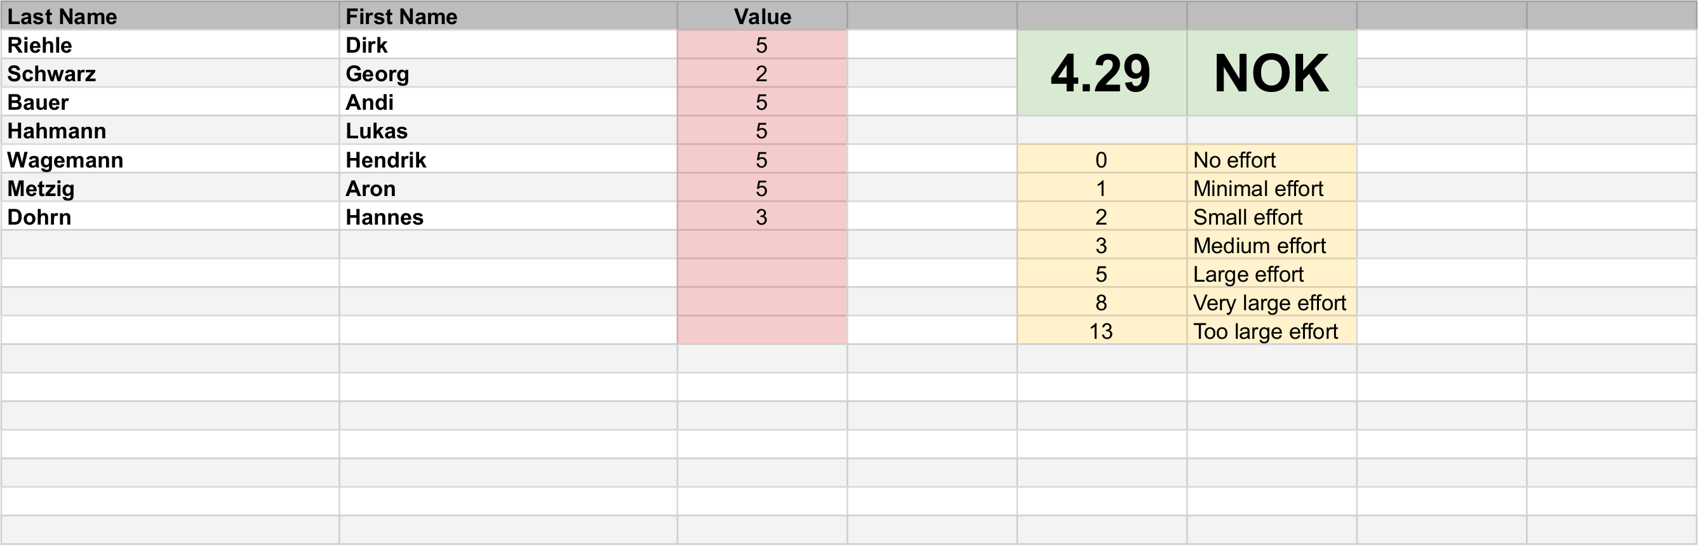
13. Planning Poker

Slide 50
Weekly Checklist for Artifacts
Software product
  Tagged, testable, deployable software code base and product
Planning documents
  Clean kanban board, release planning, additional information
Process improvement
  Impediments documented; happiness index survey taken

Slide 51
Thank you! Questions?
dirk.riehle@fau.de – http://osr.cs.fau.de
dirk@riehle.org – http://dirkriehle.com – @dirkriehle
DR

Slide 52
Credits and License
Original version
  © 2021 Dirk Riehle, some rights reserved
  Licensed under Creative Commons Attribution 4.0 International License
Contributions
  None yet

